Slide 1
Assignment 2 Foundation Of Data Science
Analyzing Screen Time and Wellness
- Rupin Raj Kanet
-Mahmudur Rahman Ifat

Slide 2
Introduction
Even though digital media is essential for entertainment, socialization, and education, worries have been expressed over its possible detrimental impacts on mental health and well-being, especially in young people.
Using this investigation, we intend to offer insights that can help guide policy suggestions for teenagers' healthier screen usage.

Slide 3
Objective
This project investigates the relationship between teenage self-reported well-being and digital screen time. Using three datasets that record daily screen time, demographic data, and well-being markers we seek to:
Describe the trends in the time spent on screens by various demographic groupings.
Analyse the self-reported well-being score distribution.
Investigate the connection between different forms of screen time (such as time spent on TV, computers, or smartphones) and markers of well-being.
Examine if variations in teenage well-being may be predicted by demographic variables and screen time.

Slide 4
Data Overview
Demographics (Dataset 1)
Respondents: 120,000+
Key Variables:
ID, Gender, Minority Status, Deprivation Status
Purpose: Analyze demographic effects on screen time and well-being.
2. Screen Time (Dataset 2)
Respondents: 113,000+ (subset of Dataset 1)
Key Variables:
Computer, Video Game, Smartphone, TV usage (weekdays & weekends)
Purpose: Investigate screen time patterns.

Slide 5
Data overview
3. Well-Being (Dataset 3)
Respondents: 102,580 (subset of Dataset 2)
Key Variables:
Optimism, Relaxation, Cheerfulness (scored 1-5)
Purpose: Explore the link between screen time and well-being.
This overview provides a high-level synopsis of the data, emphasising important factors and the function of each dataset for your investigation.

Slide 6
Methodology

Slide 7
Data Preparation
Merging the three datasets using the unique ID for each respondent.
Cleaning the data by ensuring that variables are formatted correctly for analysis and handling missing values by imputation or exclusion.
Transformation of data by grouping the screen time variables by device type.

Slide 8
Descriptive Analysis
Goal: Highlight significant data trends.
Bar charts and histograms can display the distribution of screen time by gender, minority status, and deprivation level.
Distribution of Well-Being: Use histograms to plot the distribution of well-being indicators in order to display the sample's overall well-being ratings.
Correlation Matrix: Use a heatmap to visualize the connections between factors related to screen time and markers of well-being.

Slide 9
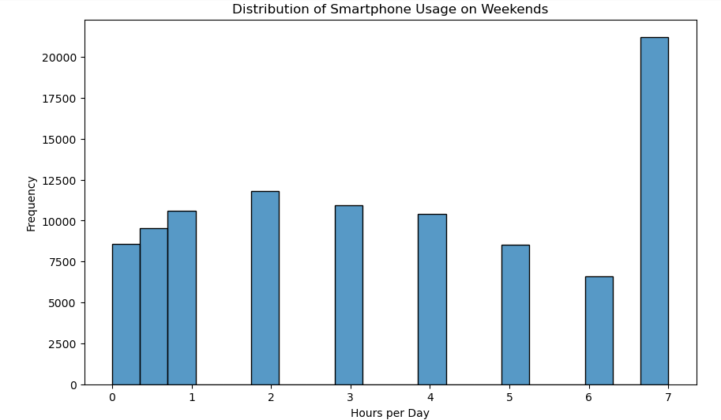
Descriptive Analysis
Histogram for Smartphone Usage on Weekends:
Objective: To analyze the distribution of smartphone usage on weekends.
Interpretation: The Histogram visaulizes how many hours per day individuals use their smartphones on weekends. Peaks in the histogram can indicate common usage patterns.

Slide 10
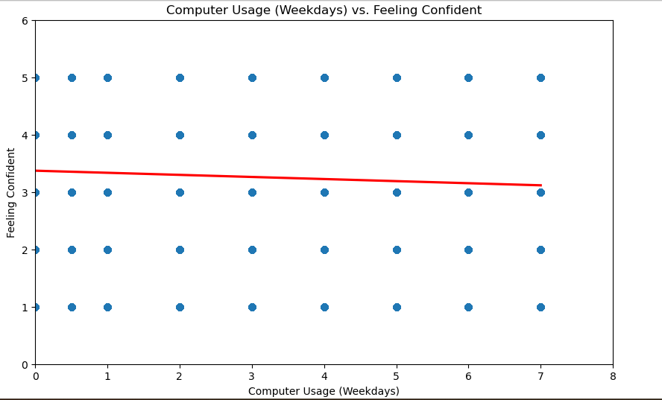
Descriptive Analysis
2. Regression Plot (Computer Usage (Weekdays) vs. Feeling Confident)
Observation: The scatter plot shows the relationship between
computer usage on weekdays and the feeling of confidence.
Interpretation: The relationship between weekday computer usage and confidence is weak and slightly negative, implying that increased computer usage may be associated with a minor decrease in confidence, but this effect is minimal.

Slide 11
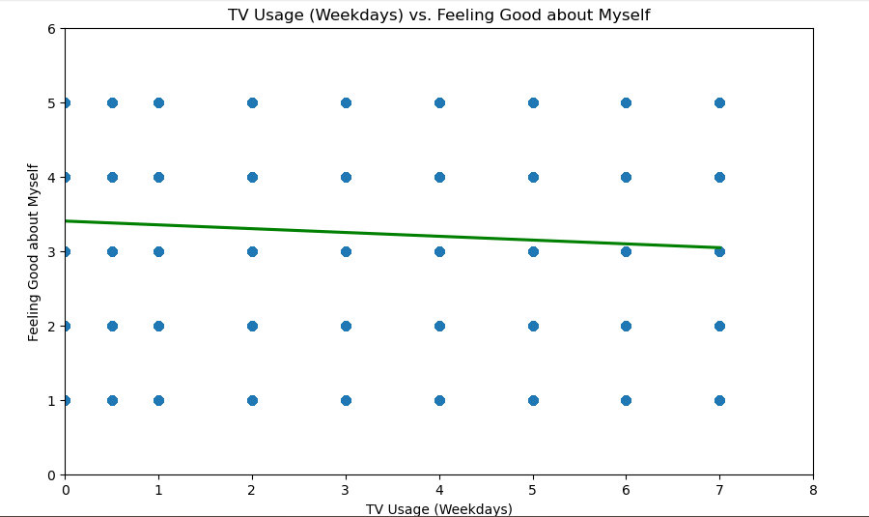
Descriptive Analysis
3. Regression Plot(TV Usage vs. Feeling Good about Myself)
Observation: The plot illustrates the relationship between TV usage on weekdays and feelings of self-worth. The regression line, depicted in green, shows a slight downward trend.
Interpretation: This indicates a negative correlation, suggesting that increased TV usage is slightly associated with a decrease in feeling good about oneself. However, the slope of the line is relatively flat, implying that this relationship is weak.

Slide 12
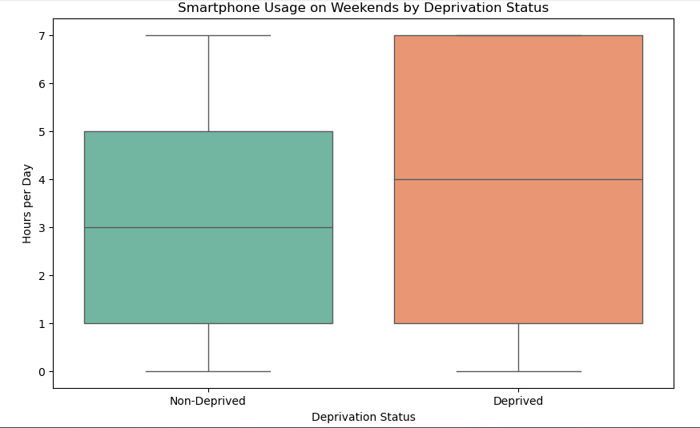
Descriptive Analysis
4. Box plot for Smartphone Usage Across Deprivation Status:
Objective: To compare smartphone usage on weekends between deprived and non deprived groups.
Interpretation: The box plot visualizes the distribution of smartphone usage across two groups, highlighting significant differences between them.

Slide 13
Inferential Analysis
Goal: Evaluate connections and theories.
Correlation Analysis: Using Pearson or Spearman correlation to evaluate the degree of association between overall screen time (as well as particular device types) and well-being markers.
Regression Analysis: Use multiple regression to predict well-being outcomes (e.g., optimism, and relaxation) based on screen time and demographic variables (gender, minority status, deprivation status).
Testing Hypotheses: To compare well-being between groups (e.g., high vs. low screen time users), utilize t-tests or an ANOVA.

Slide 14
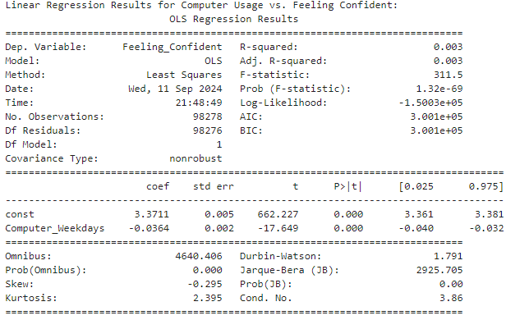
Inferential Analysis
1. Linear Regression for Computer Usage vs. Feeling Confident
Objective: To analyze whether computer usage on weekdays is a predictor of feeling confident.
Method: Ordinary Least Squares(OLS) regression is used to model the relationship between the independent variable(Computer_Weekdays) and the dependent variable(Feeling_Confident)

Slide 15
Inferential Analysis
Result: The regression output shows the strength and significance of the relationship, including the coefficient and p-values.
Coefficient (coef): -0.0364
p-Value (P>|t|): 0.000
Increased computer usage on weekdays is significantly associated with a decrease in the "Feeling Confident" score. Each additional hour of computer use correlates with a reduction of approximately 0.0364 units in confidence.

Slide 16
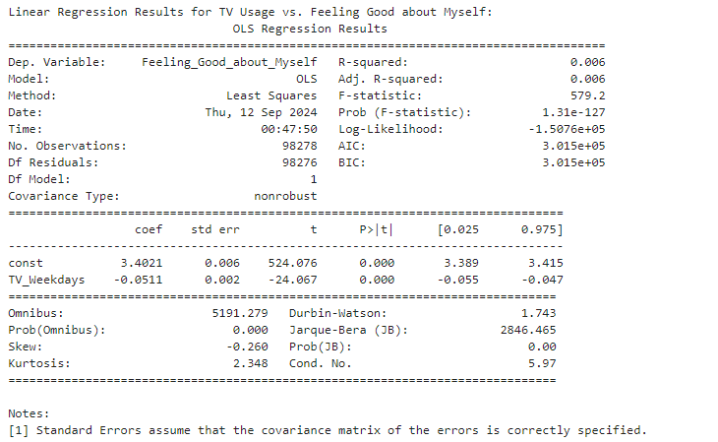
Inferential Analysis
2. Linear Regression for TV Usage vs. Feeling Good About Myself:
Objective: To analyze whether TV usage on weekdays is a predictor of feeling good about oneself.
Method: OLS regression is used to model the relationship between the independent variable(TV_Weekdays) and the dependent variable(Feeling _Good_about_MySelf)

Slide 17
Inferential Analysis
Result: The output shows the significant of the relationship.
Coefficient (coef): -0.0511
p-Value (P>|t|): 0.000
R-squared: 0.006
There is a statistically significant negative relationship between TV usage on weekdays and the feeling of being good about oneself. Each additional hour of TV usage correlates with a decrease of approximately 0.0511 units in the "Feeling Good About Myself" score. The model explains only 0.6% of the variance in the well-being outcome, suggesting other factors may be influencing this relationship.

Slide 18
Inferential Analysis
3. T-Test for Differences in Smartphone Usage by Deprivation Status:
Objective: To test whether there is a significant difference in smartphone usage between deprived and non deprived groups.
Method: A two sample t-test can be performed to compare the means of two independent groups.
T-test results: t-stat = 25.621950926047838, p-value = 2.596355923964005e-144
The p-value is below 0.05, there is a significant difference in smartphone usage between the two groups.

